Slide 1


Water Marking Application
(Built using Python)
Important Note:
This is a beta version and is under testing phase.
Some bugs are there which will be resolved soon IA

Slide 2
Usage Instructions

Slide 3
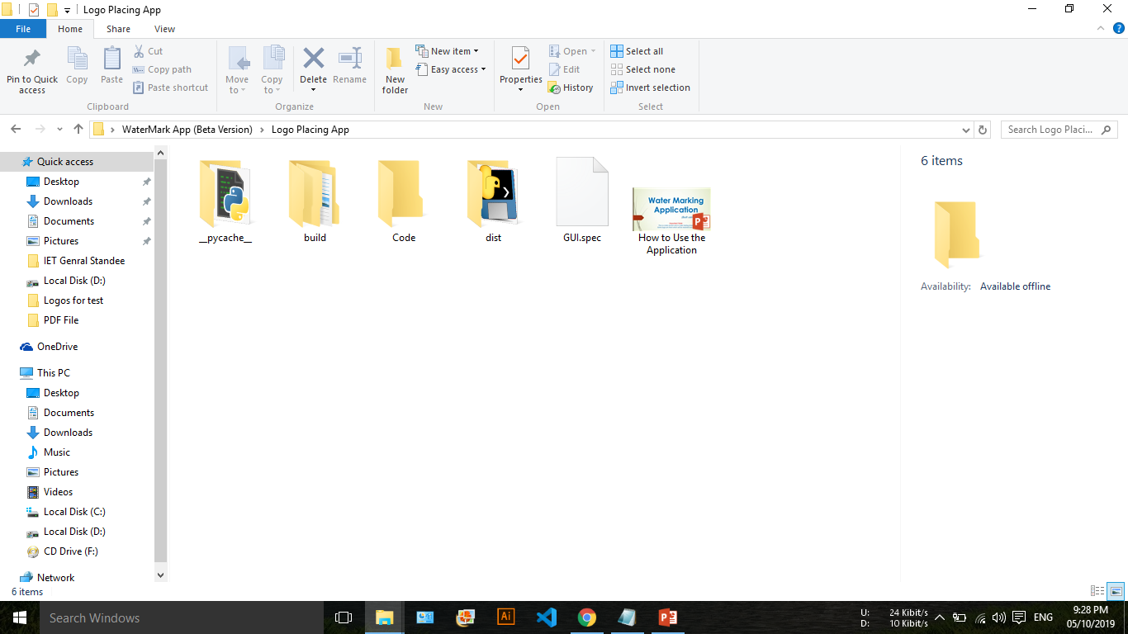
1. Launch the “GUI.exe” file from the folder “dist” as shown in the image below

Slide 4
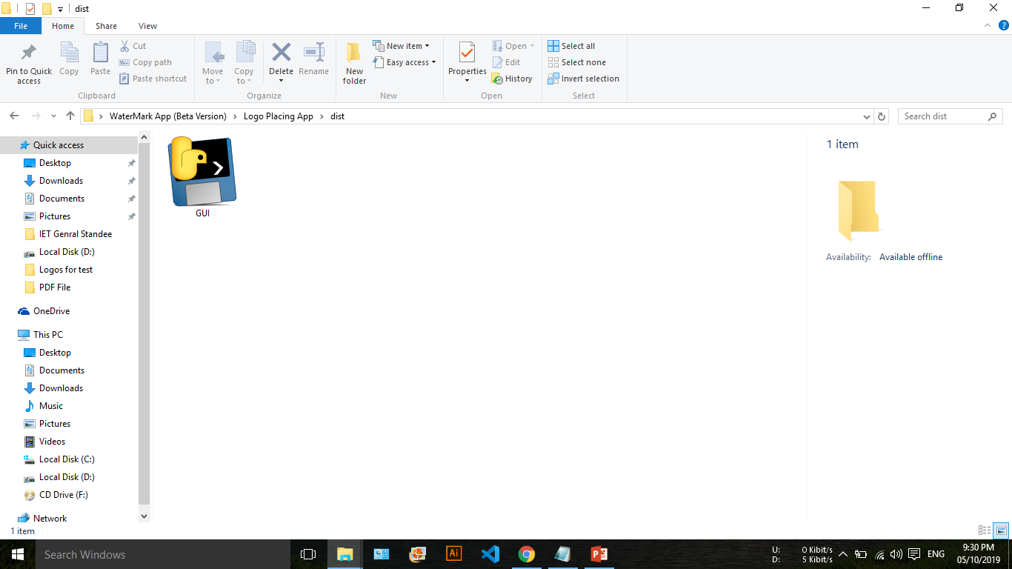

Slide 5
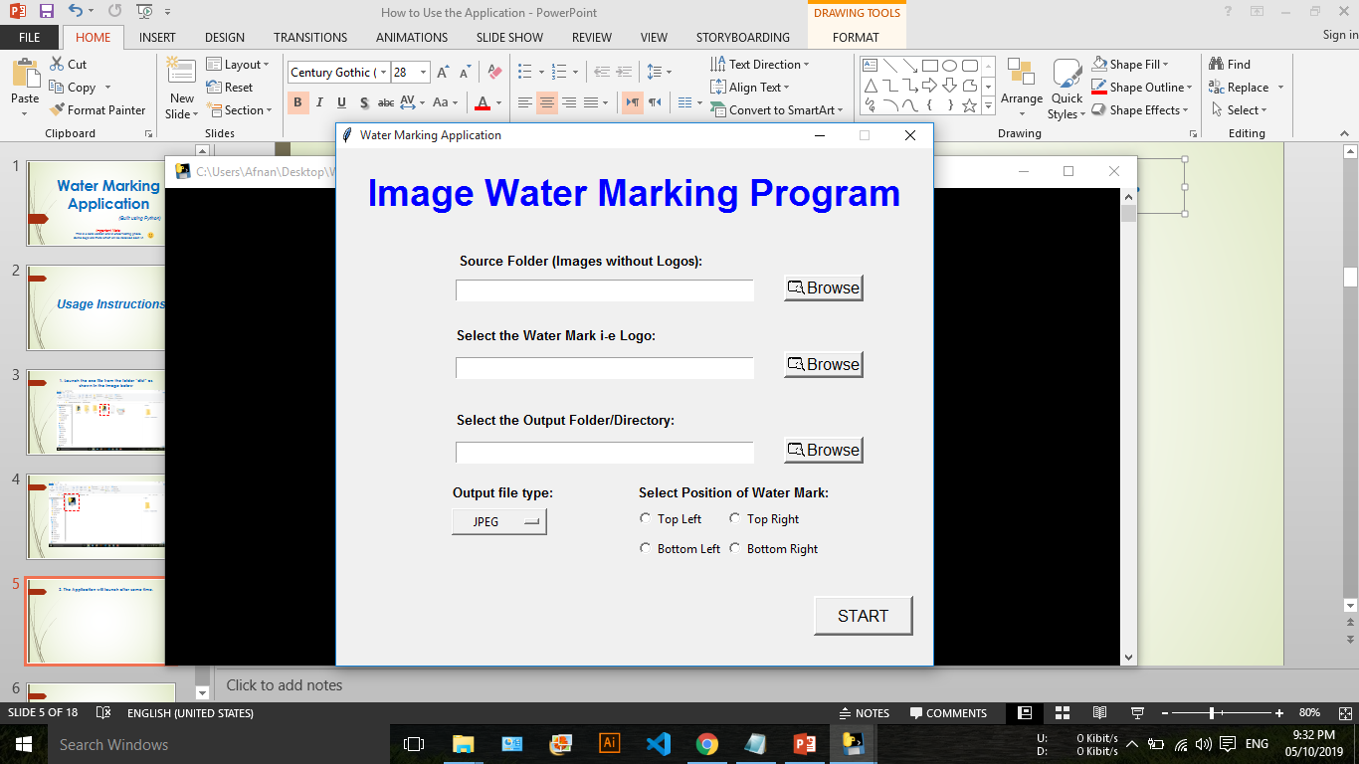
2. The Application will launch after some time.

Slide 6

Please Don’t Close the Black CMD window behind the application otherwise the program will terminate.

Slide 7
For Logo Placing/Water Marking we need 3 things:
Source Images Folder (without logos)
Logo file (Either PNG or JPEG)
Output/Destination Folder

Slide 8
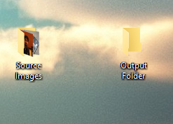
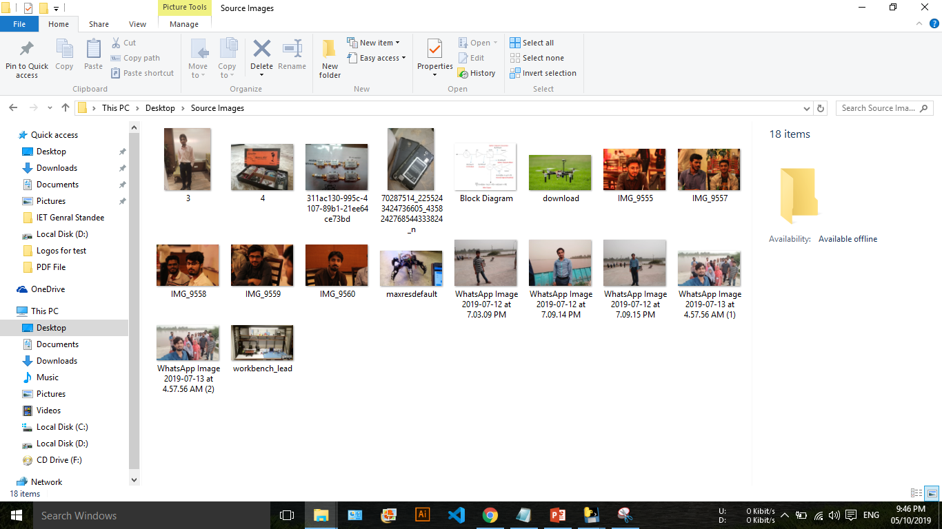
3. I created 2 folders on my Desktop. First One is of “Source Images” and the other one is the “Output Folder”.
I also copied all my source images (those which are to be watermarked) inside the “Source Images Folder”
Source Images copied in the folder

Slide 9
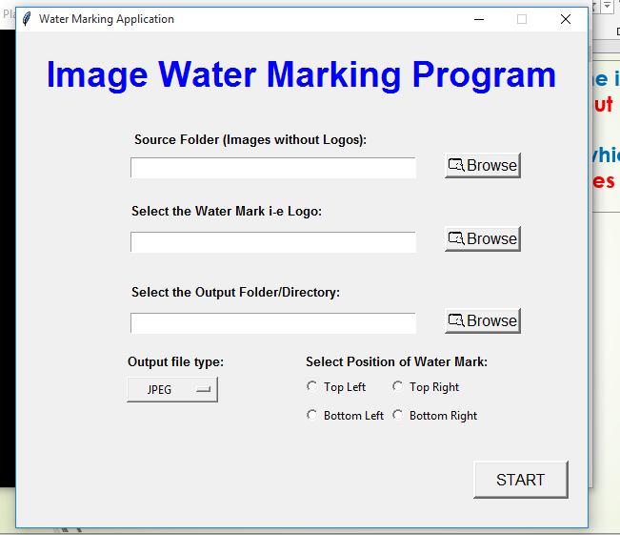
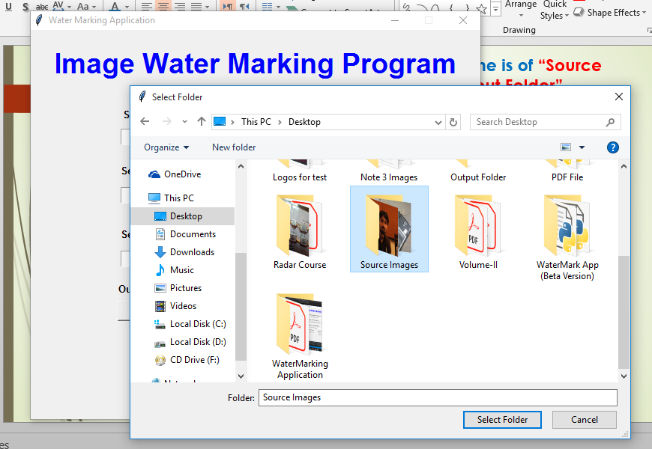
4. Click on the “Browse Button”. A new window will pop as show on right bottom pic.
Select the “Source Folder” of the pictures which we created earlier.

Slide 10
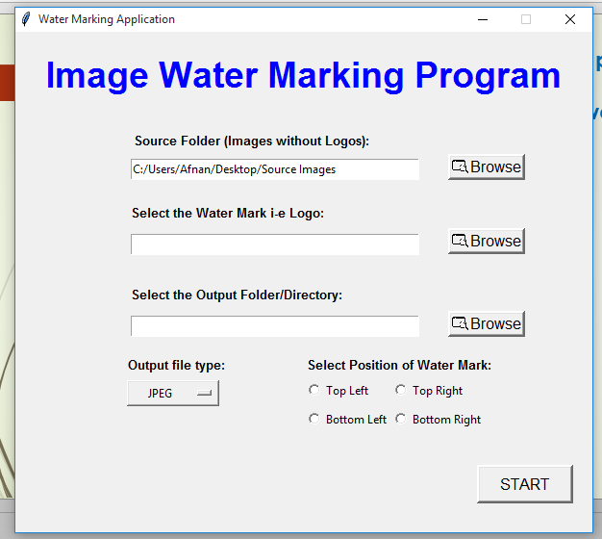
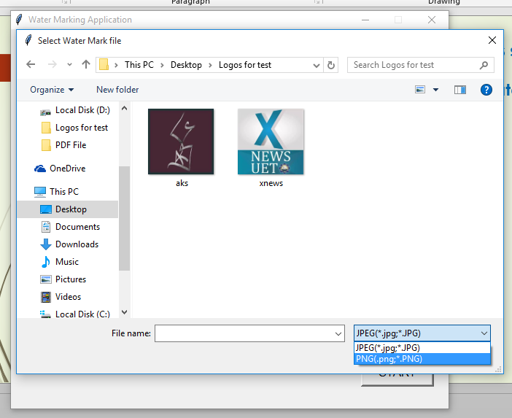
Click on the “Browse Button”. A new window will show up in order to select the logo file.
You can use either PNG or JPEG logo. I will be using PNG so I selected “PNG” from the file type.

Slide 11
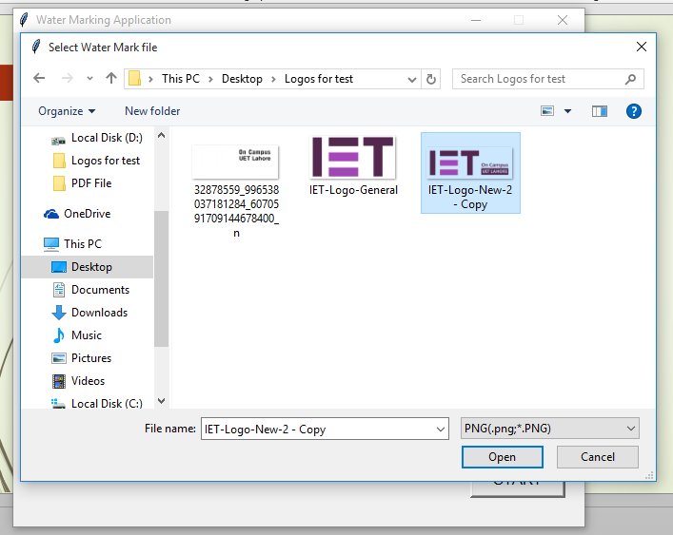

Slide 12
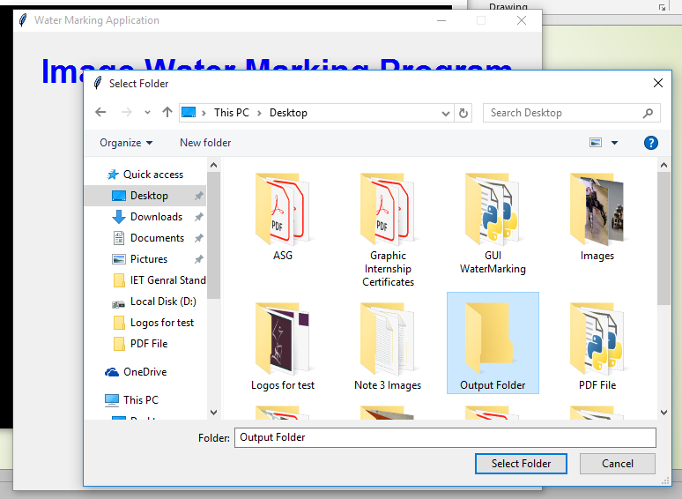
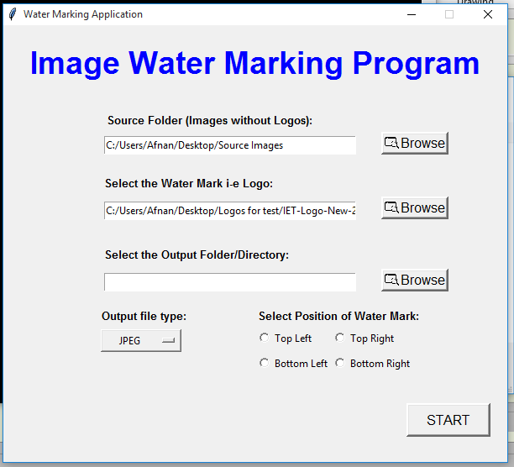
5. Click on the “Browse Button”. A new window will apper as show on right bottom image.
Select the “Output Folder” which we created earlier.

Slide 13
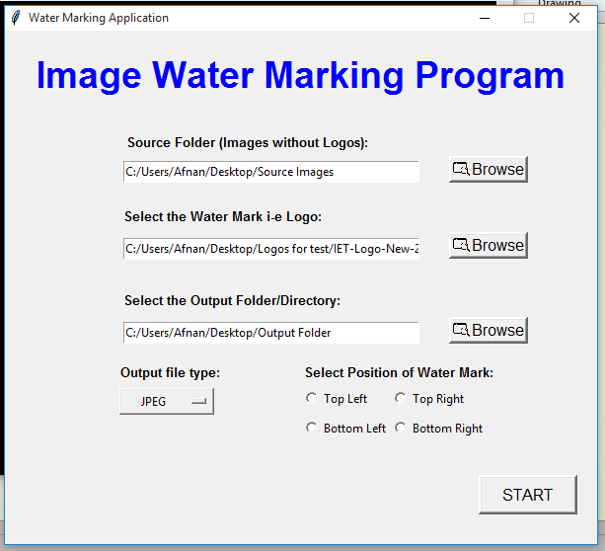
After the Selection of 3 fields we get something like this

Slide 14
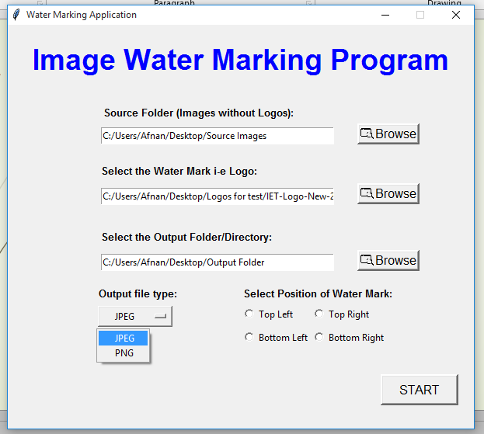
6. Select “Output file type” for the images to be watermarked. JPEG is preferred here as sometimes PNG size gets way too large for High Resolution Images (Like From DSLR).

Slide 15
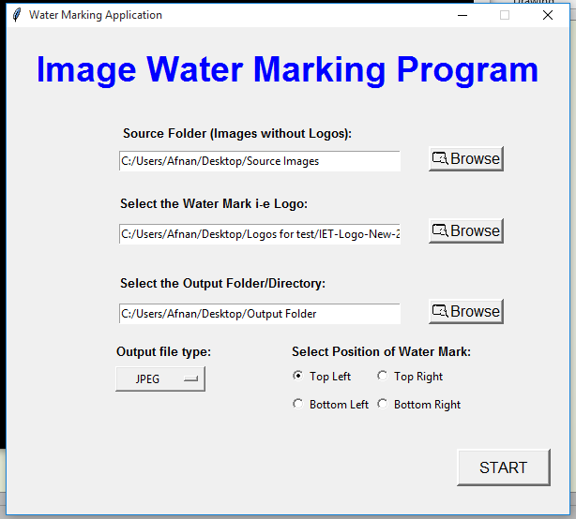
6. Select “Position” of water mark. Click “Start”

Slide 16
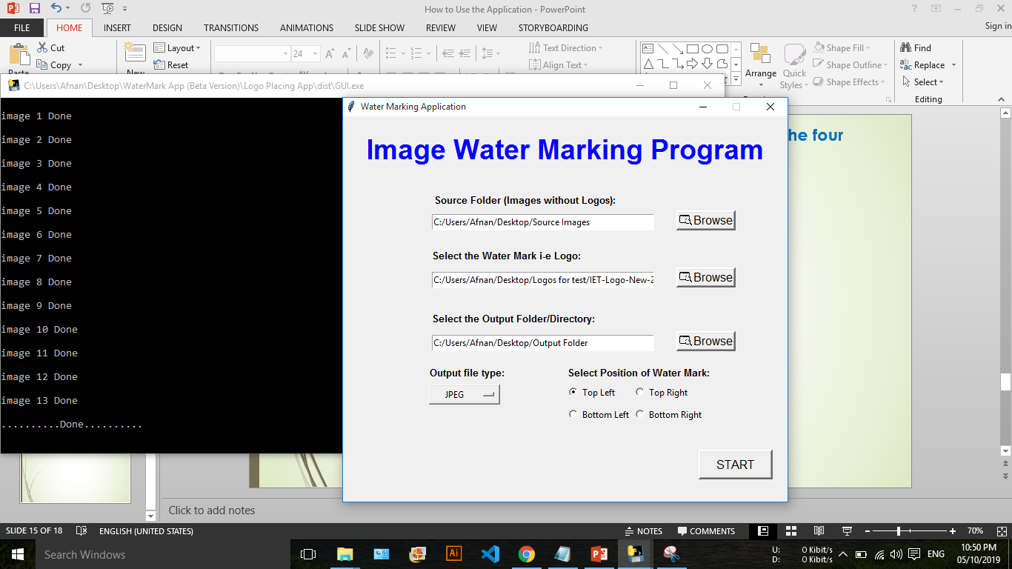
7. After you click “Start” , the program will start watermarking your images. You can see the progress and done images in Black CMD window behind the program.

Slide 17
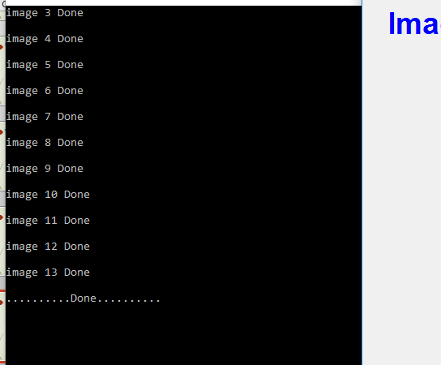
8. You can see “…..Done…..” in the cmd window.
Sometimes If you have large number images (Python program will window will show as not responding), don’t worry on that thing. Let the program finish its process.

Slide 18
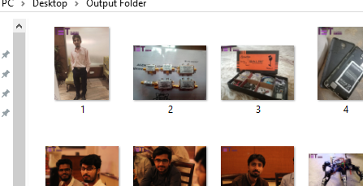

Images Water Marked
(No need to use Photoshop)

Slide 19
For Contact or Queries
Afnan Mahmood
Phone No: 0322 4957376
Email: afnanmahmood52@gmail.com
Suggestions and Improvements are always welcome.

